Slide 1



Web Application
for AIESEC in Ruhuna
ICT3283 – Group Project
Group Number 14
Group Name : Techies
Supervisor: [Supervisor Name]
Date: 14th February 2025
Group Members:
TG/2021/1031 – K.K.Christina
TG/2021/1045 – M.N.F. Sajeeya
TG/2021/1051 – I.S.Palangasinghe
TG/2021/1067 – Hewage N.U.M

Slide 2


Introduction
Our Project focuses web-based platform for AIESEC in Ruhuna to manage events, tasks, finances, and members efficiently.
1

Slide 3







Problem Statement
Inefficient communication for event updates and notifications.
No dedicated event gallery for member me
management
Lack of a centralized system for managing tasks and events.
Manual tracking of member progress and financial records.
2

Slide 4

Aim
To develop a comprehensive web application that enhances operational efficiency within AIESEC in Ruhuna.
3

Slide 5
Objectives
To implement a secure user login system for role-based access control.
To enable task assignment with deadlines and automated email notifications.
To automate financial report generation and bill tracking for improved transparency.
To provide event management features, including event booklets and dress code notices.
To establish an event gallery for storing and organizing event media.
To implement an automated birthday notification system for member engagement.
4

Slide 6



User management
Task assignment and notifications
Scope of Work
Finance management
Event creation and management
Mobile application development
Event gallery
Birthday notifications
Third-party integrations (e.g., payment gateways)
5

Slide 7

Methodology:
Agile
6

Slide 8



Technologies & Tools
BACKEND
Java with Spring Boot
DATABASE
MySQL
HOSTING
AWS/Google Cloud/Microsoft Azure
PROJECT MANAGEMENT
Jira
VERSION CONTROL
GitHub
7

Slide 9


Target Audience
ADMINS WILL MANAGE USERS, ASSIGN TASKS, CREATE EVENTS, TRACK FINANCIAL RECORDS.
AIESEC
MEMBERS
MEMBERS WILL USE THE PLATFORM TO RECEIVE TASK ASSIGNMENTS, TRACK DEADLINES, REGISTER FOR EVENTS, AND STAY UPDATED WITH ORGANIZATION ACTIVITIES.
ADMIN
8

Slide 10

Time Line
Requirements Gethering and Analysis
Design and Development Stage
Testing and Quality Assurance
Deployment and Implementation
Training and Support
•Gather client requirements
•Analyze business needs
•Define project scope
•Deploy applications to production environment
•Configure systems
•Ensure smooth transition from development to live environment
•Design user interfaces
•develop mobile and backend applications
•integrate databases
•Conduct unit testing, integration testing, and user acceptance testing to ensure functionality and reliability.
•Offer ongoing support and maintenance post-deployment
2 Weeks
8 Weeks
2 Weeks
1 Weeks
1 Weeks
9

Slide 11

Estimated Costs
Web Hosting | 15000 LKR
com Domain | 3600 LKR
Total | 18600 LKR
10

Slide 12
Risk Assessment
Technical Risks
06
User Adoption Issues
01
Resistance to change and lack of training.
Issues with system integration and security.
07
02
Data Security Threats
Dependency Risks
Problems with third-party APIs and compliance.
Risks of breaches and vulnerabilities.
03
Communication Breakdowns
03
Misunderstandings or delayed feedback.
Scope Creep
04
Uncontrolled feature additions causing delays.
05
Resource Constraints
05
Limited team availability and expertise.
11

Slide 13

TG/2021/1067 - User Management
User Authentication & Roles
Role Management & Permissions
Security & Authentication
Implement user registration with email verification.
Develop a secure login/logout system
Create forgot password and account recovery features.
Define admin, committee members
Implement role-based access control (RBAC) to restrict functionalities.
Manage user profile updates and settings
Encrypt passwords using hashing algorithms
12

Slide 14
TG/2021/1031 - Task Management
Task Assignment & Tracking
Dashboard & Progress Tracking
Notifications & Reminders
Develop an interface for task creation and assignment.
Enable task prioritization (urgent, normal, low priority).
Assign tasks to multiple members with deadlines.
Create a personalized user dashboard showing assigned tasks.
Display task progress (Not Started, In Progress, Completed).
Implement filter & search functionality for tasks.
Implement alerts task deadlines.
13

Slide 15
TG/2021/1051 - Event Management
Event Creation & Coordination
Event Documents & Logistics
Event Registration & Attendance Tracking
Event Gallery
Develop a form for event creation with date, time, and venue.
Allow modification & cancellation of events.
Upload event booklets, notices, and guidelines.
Manage T-shirt pack orders, including size selection and quantities
Allow members to register for events online.
Generate attendance reports for organizers.
Implement photo & video upload feature.
Categorize event albums by type.
14

Slide 16
TG/2021/1045 - Finance,Announcement and Birthday Management
Finance Management
Birthday Management
Announcement Management
Implement invoice generation with unique invoice IDs.
Develop expense tracking system.
Implement an automated birthday reminder system.
Display upcoming birthdays on dashboards.
Announcements Section:
Display important updates for all
members.
• Feedback & Suggestions:
Allow members to submit
feedback.
15

Slide 17
Communicating and Reporting
Communication Handling
Reporting Mechanisms
Team Meetings
Regular meetings to discuss progress and plan.
Progress Reports
Detailed updates on project milestones and achievements.
Issue Tracking
Jira will serve as the platform to log and monitor project issues, ensuring timely resolution.
Stakeholder Updates
Meetings to keep stakeholders informed and gather feedback.
16

Slide 18
Hardware and Software Requirements
Hardware Requirements
Software Requirements
Server-Side:
Processor: Intel Xeon / AMD EPYC
RAM: 32GB+
Storage: 1TB SSD/NVMe (RAID for redundancy)
Network: 1 Gbps+
Client-Side:
Processor: Dual-core (Intel i3/i5, AMD Ryzen 3/5)
RAM: 4GB (8GB recommended)
Storage: 20GB free space
Internet: 5 Mbps+ (10+ Mbps for media)
Server-Side:
OS: Cloud Linux 6.x
Database: MySQL
Backend: Spring Boot, Node Server (npm)
Cloud Hosting: AWS / Google Cloud / Azure
Client-Side:
OS: Windows 10
Browser: Chrome / Firefox / Opera
17

Slide 19
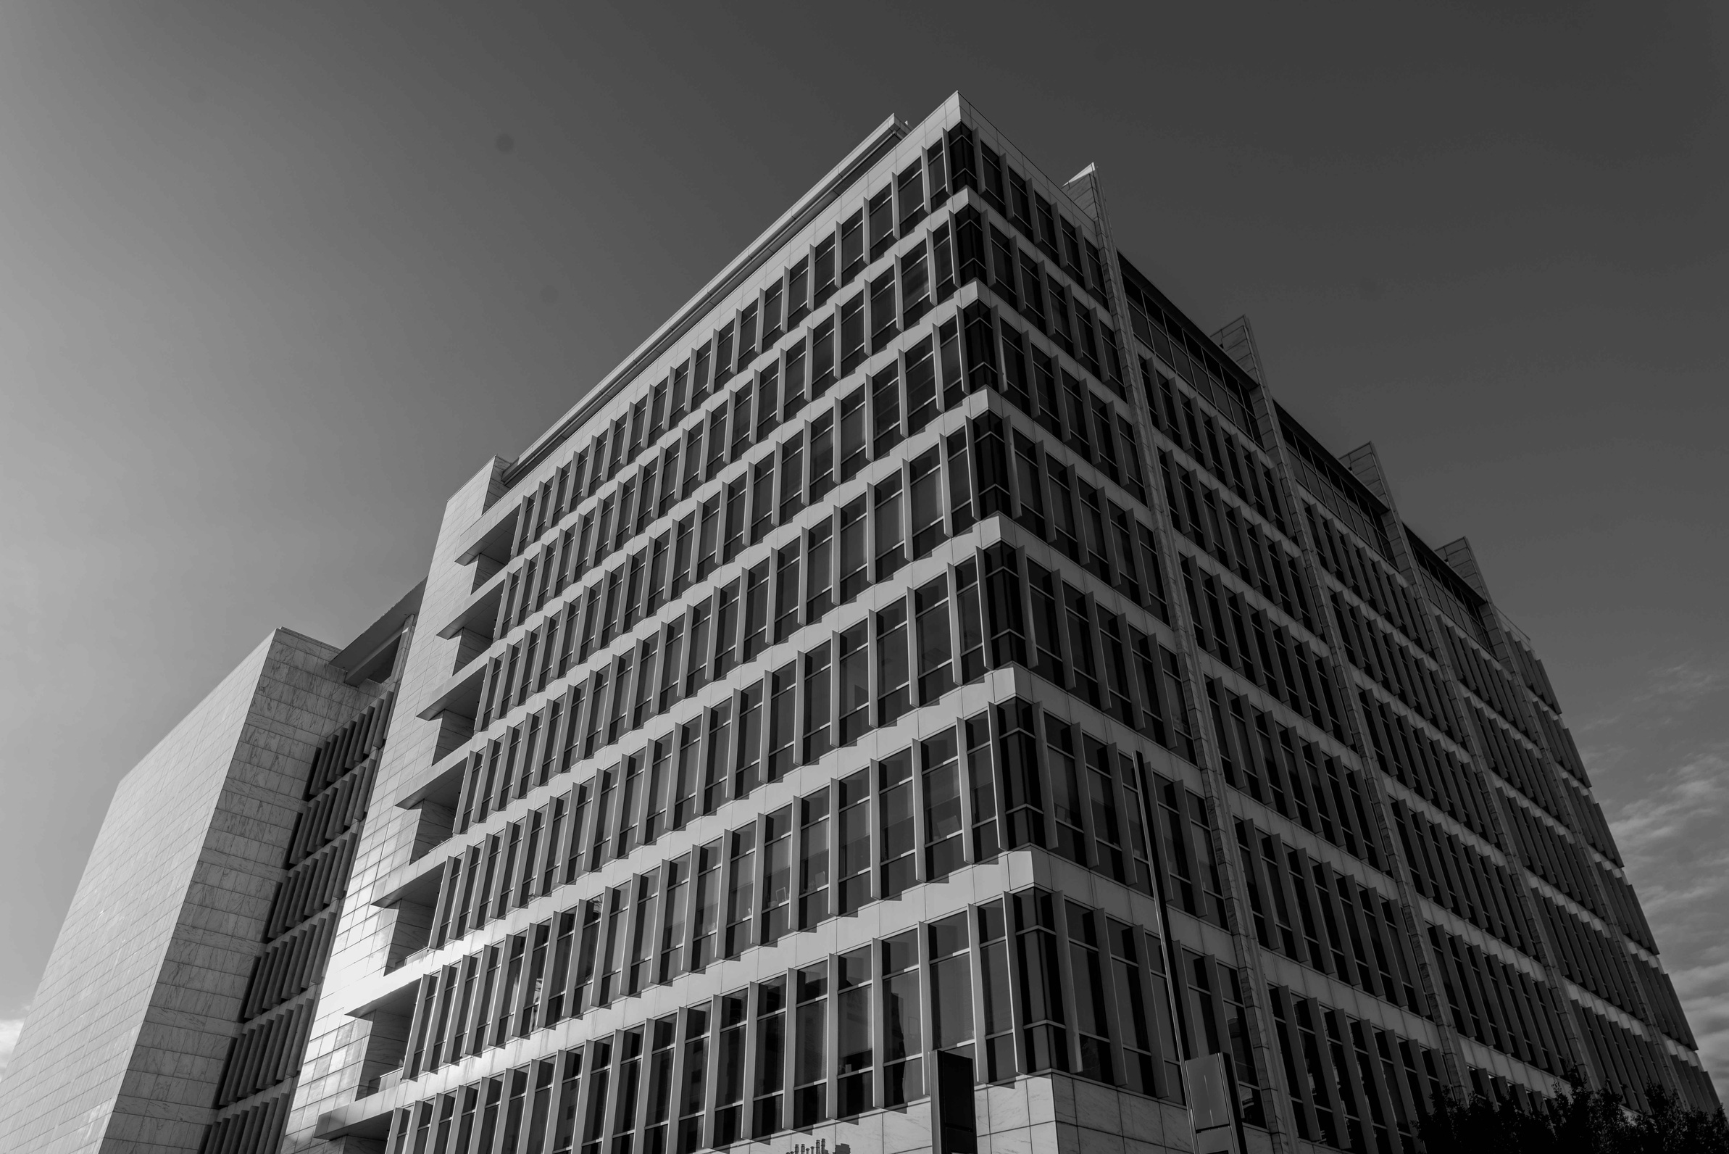
Testing and Quality Assurance
Testing Methods:
Unit testing:
Testing individual components or modules to ensure they function correctly in isolation.
Integration Testing
Verifying that different components work together when integrated into the system.
User Acceptance Testing (UAT)
Evaluating the system's usability and functionality from an end-user perspective to ensure it meets
requirements.
18

Slide 20
Testing and Quality Assurance
Quality Assurance Process:
🛠️ Code Reviews
Ensures high-quality, error-free code before merging
🤖 Continuous Integration (CI)
Automates code integration, building & testing
📊 Performance Testing
Measures system speed, scalability, & efficiency
🔒 Security Testing
Detects and fixes vulnerabilities, protecting user data
19

Slide 21

Conclusion
Our AIESEC web application is designed to streamline operations, enhance user engagement, and improve overall efficiency. By providing a seamless platform for managing memberships, events, and communications, the system ensures a user-friendly experience for both members and administrators. With a focus on scalability and security, our solution supports AIESEC’s mission of connecting young leaders worldwide, fostering collaboration, and driving impactful change.
20

Slide 22
Reference
[1] AIESEC Ruhuna, "AIESEC in Ruhuna," [Online].
Available: https://aiesec-ruhuna.github.io/. [Accessed: 11-Feb-2025].
21

Slide 23


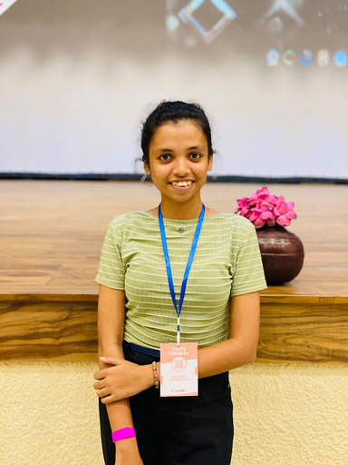


TEAM
K.K.CHRISTINA
HEWAGE.N.U.M
M.R.F.SAJEEYA
I.S.PALANGASINGHE
22

Slide 24
QUESTIONS ?
23

Slide 25
Thankyou...!
24

